Slide 1
Introduction to Statistical Methods
ISM Team

Slide 2
Session 1:
Overview of the course
& Descriptive Statistics
(Session 1: 6th /7th November 2021)

Slide 3
Overview of the course
TEXT BOOK
Probability and Statistics for Engineering and Sciences,
8th Edition, Jay L Devore, Cengage Learning

Slide 4
Overview of the course
Descriptive Statistics
Probability
Conditional Probability
Random Variables
Probability Distributions – Univariate & Joint
Sampling & Estimation
Testing of Hypothesis – mean , proportions
Regression
Time Series Analysis

Slide 5
Contact Session | List of Topic Title | Reference
CS - 1 | Descriptive Statistics: Data Visualisation, Measures of Central Tendency, Measures of Variability | T1:Chapter 1

Slide 6
Evaluation Components
Quiz 2 - 5%
Assignment 1– 7%
Assignment 2 – 8%
Mid – 30%
Quiz 1 – 5%
Compre – 45%
Assignment submission is individual

Slide 7
“Statistical thinking will be one day as necessary for efficient citizenship as the ability to read and write”
H G Wells

Slide 8
!!!!
A famous statistician would never travel by airplane, because she had studied air travel and estimated the probability of there being a bomb on any given flight was 1 in a million, and she was not prepared to accept these odds.
One day a colleague met her at a conference far from home.
"How did you get here, by train?"
"No, I flew"
"What about the possibility of a bomb?"
"Well, I began thinking that if the odds of one bomb are 1:million, then the odds of TWO bombs are (1/1,000,000) x (1/1,000,000) = 10⁻¹². This is a very, very small probability, which I can accept. So, now I bring my own bomb along!"

Slide 9
Statistics may be defined as science that is employed to
Collect the data
Present and organize the data in a systematic manner
Analyse the data
Infer about the data
Take decision from the data.
Statistics may be defined as numerical data with a view to analyse it.

Slide 10
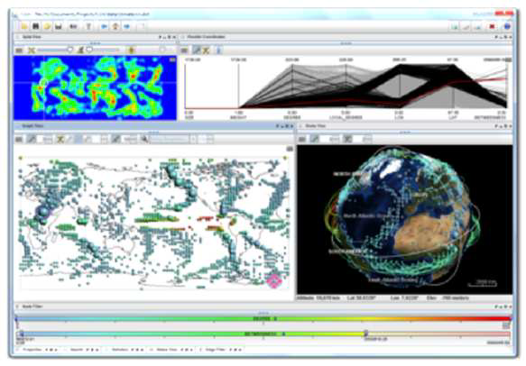
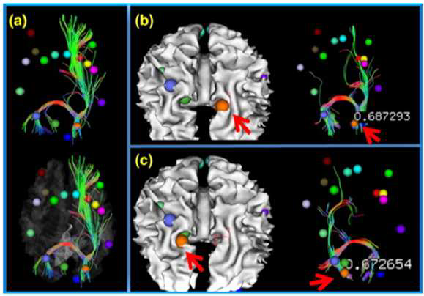
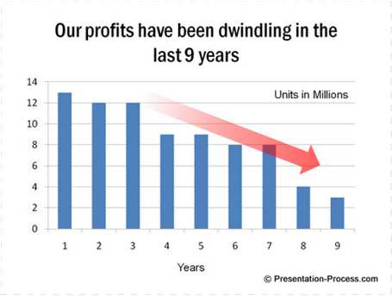
Need for Data Visualization
Tool to enable a user get insight into data
Broadly three types of goals:
• To explore:
Nothing is known
Required to get an insight
To analyze :
There are hypotheses
Used for verification or falsification
To present:
We have the required information
Used for communication of result
Source: Google images

Slide 11
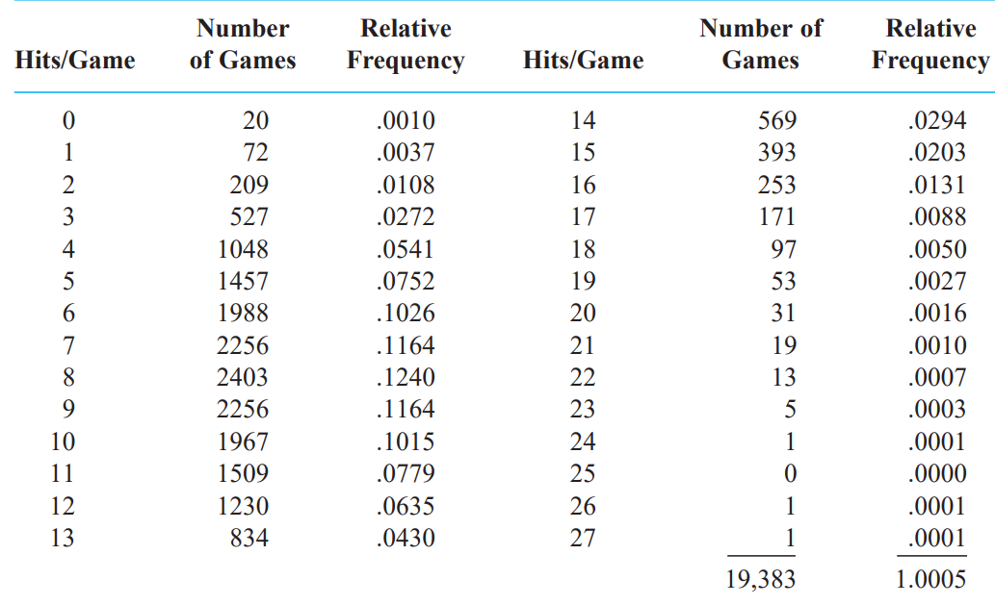

Slide 12
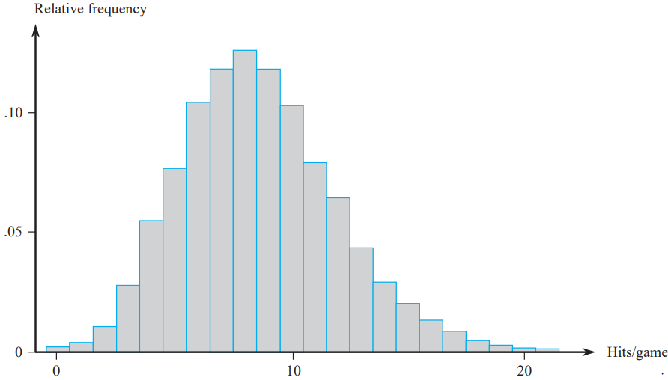

Slide 13
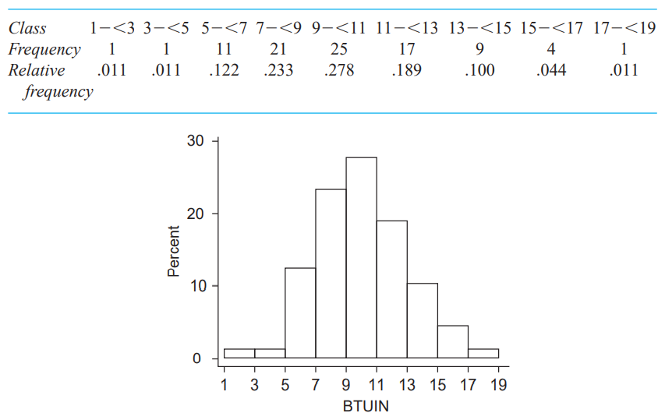
Example
Power companies need information about customer usage to obtain accurate forecasts of demands. Investigators from Wisconsin Power and Light determined energy consumption during a particular period for a sample of 90 gas-heated homes.

Slide 14
Percentage Frequency = Relative frequency x 100
For Unequal Class Widths, after determining frequencies and relative frequencies, calculate the height of each rectangle using the formula
rectangle height = relative frequency of the class/ class width
Example
Corrosion of reinforcing steel is a serious problem in concrete structures located in environments affected by severe weather conditions. For this reason, researchers have been investigating the use of reinforcing bars made of composite material. One study was carried out to develop guidelines for bonding glass-fibre-reinforced plastic rebars to concrete. Consider the following 48 observations on measured bond strength which are shown in a frequency distribution.

Slide 15
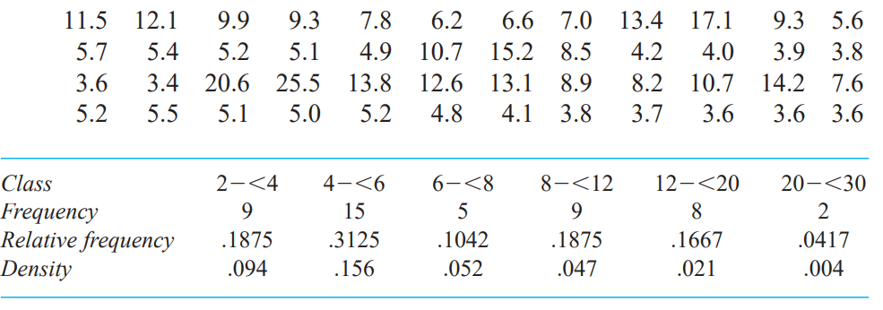

Slide 16
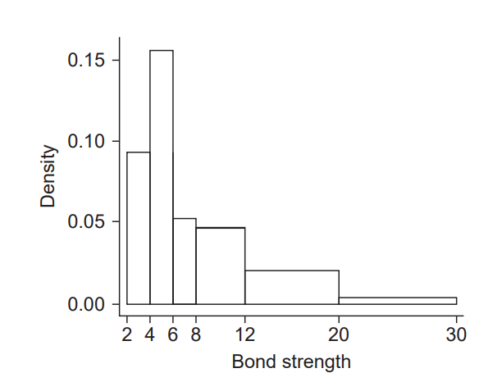

Slide 17
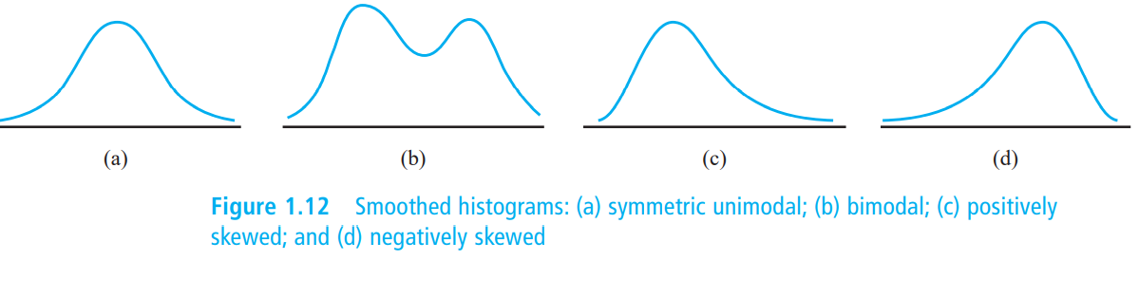
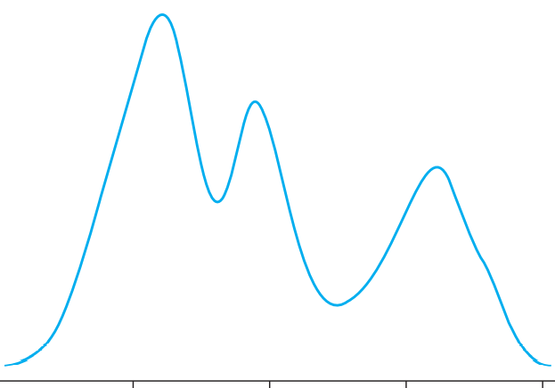

Slide 18
Statistical Visualization
A picture is worth a thousand words!
Bar chart / graph
Histogram
Box plot
Pie chart
Density plot
Line chart
Frequency polygons
Scatter plots

Slide 19
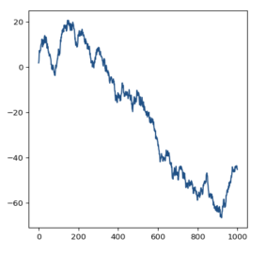
Chart Types
Line charts are great when it comes to displaying patterns of change across a continuum.

Slide 20
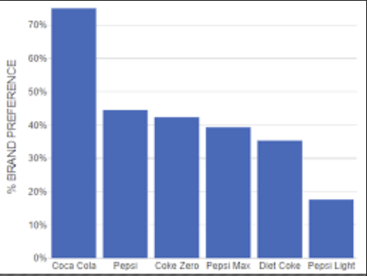
Chart Types
Choose bar charts if you want to compare items in the same category.
The objective is not just to compare but also show how much one is better or worse than the rest.

Slide 21
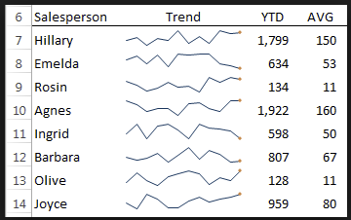
Chart Types
Sparklines usually don’t have a scale which means that users will not be able to notice individual values. They work well when you have a lot of metrics and you want to show only the trends.

Slide 22
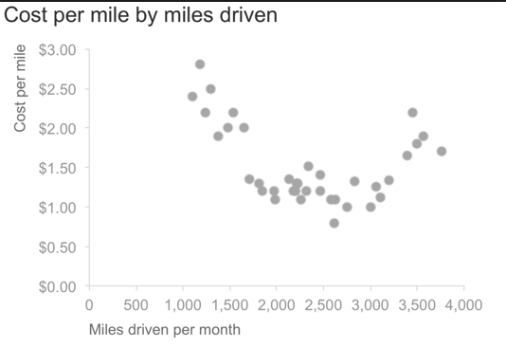
scatterplots.

Slide 23
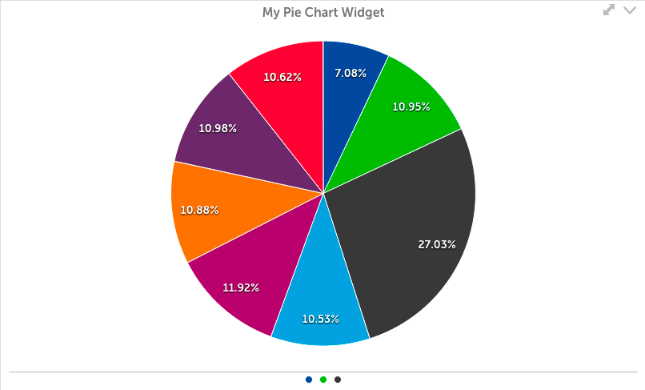
Pie Chart

Slide 24
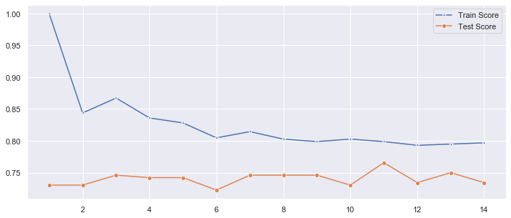

Slide 25
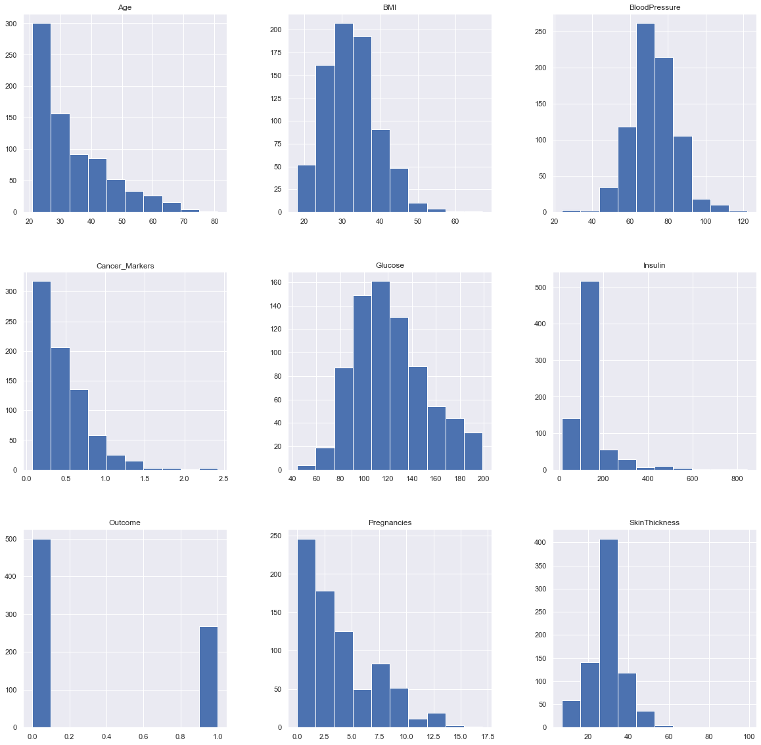

Slide 26
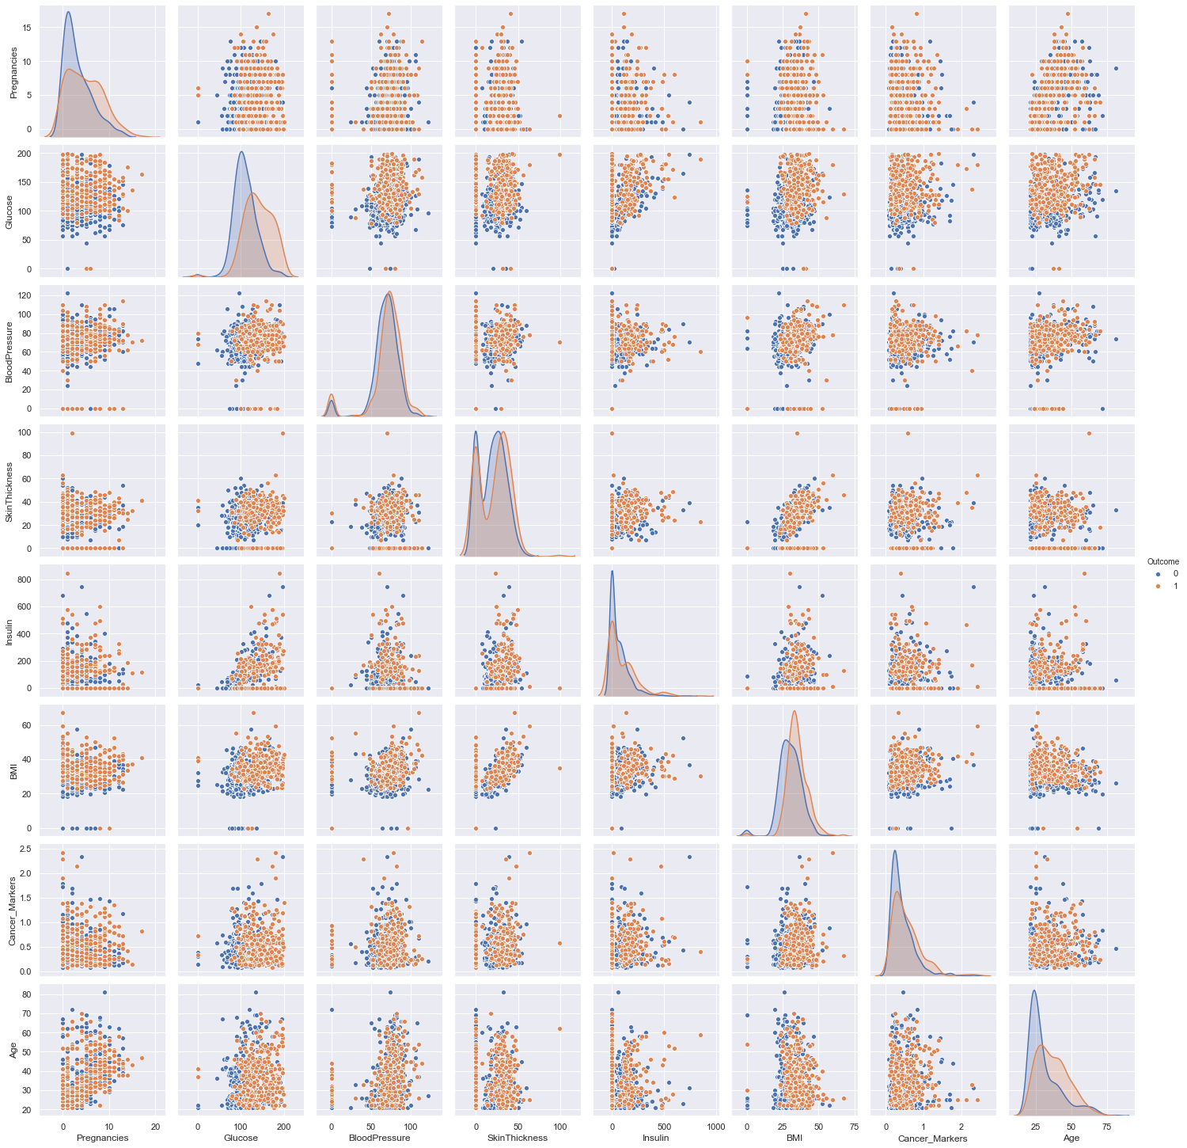

Slide 27
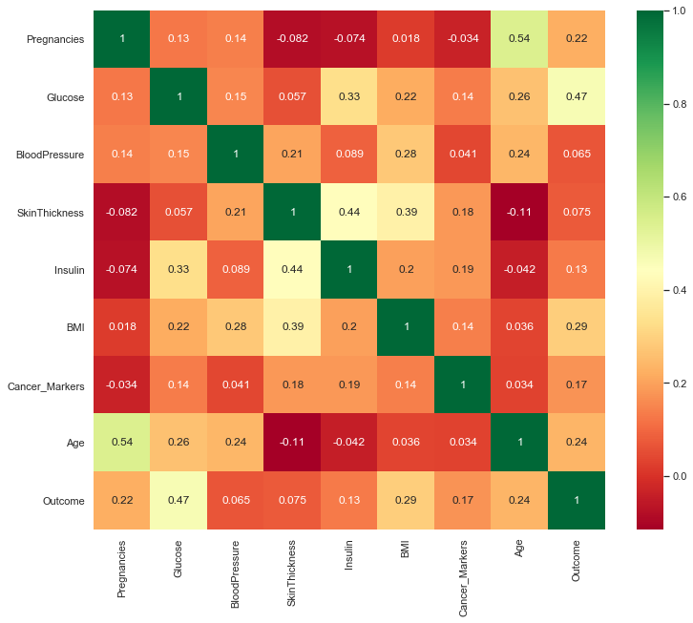

Slide 28
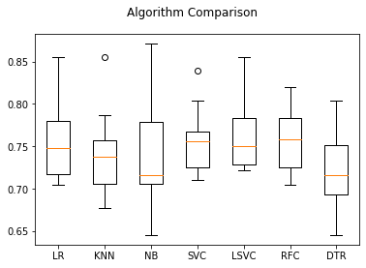

Slide 29
Statistical Summary
Cost | Weight | Weight1 | Length | Height | Width
count | 159.000000 | 159.000000 | 159.000000 | 159.000000 | 159.000000 | 159.000000
mean | 398.326415 | 26.247170 | 28.415723 | 31.227044 | 8.970994 | 4.417486
std | 357.978317 | 9.996441 | 10.716328 | 11.610246 | 4.286208 | 1.685804
min | 0.000000 | 7.500000 | 8.400000 | 8.800000 | 1.728400 | 1.047600
25% | 120.000000 | 19.050000 | 21.000000 | 23.150000 | 5.944800 | 3.385650
50% | 273.000000 | 25.200000 | 27.300000 | 29.400000 | 7.786000 | 4.248500
75% | 650.000000 | 32.700000 | 35.500000 | 39.650000 | 12.365900 | 5.584500
max | 1650.000000 | 59.000000 | 63.400000 | 68.000000 | 18.957000 | 8.142000

Slide 30
Measures of Central Tendency
Measures of Variability

Slide 31

Measures of Central Tendency
Measure of central tendency provides a very convenient way of describing a set of scores with a single number that describes the PERFORMANCE of the group.
Also defined as a single value that is used to describe the “center” of the data.
Three commonly used measures of central tendency:
Mean
Median
Mode

Slide 32
Mean
Also referred as the “arithmetic average”
The most commonly used measure of the center of data
Numbers that describe what is average or typical of the distribution
Computation of Sample Mean:
= Σ Y/ N = (Y1 + Y2 + Y3 + … Yn) / N where
“Y bar” equals the sum of all the scores, Y, divided by the number of scores, N.
Computation of the Mean for grouped Data
Where f Y = a score multiplied by its frequency

Slide 33
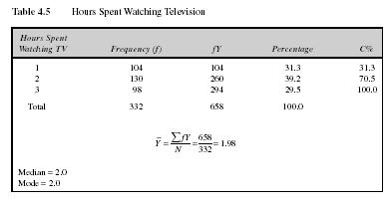
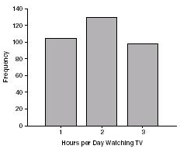
Mean: Grouped Scores
Data of Children watching TV in Bengaluru

Slide 34
Mean
Properties
It measures stability. Mean is the most stable among other measures of central tendency because every score contributes to the value of the mean.
It may easily affected by the extreme scores.
The sum of each score’s distance from the mean is zero.
It can be applied to interval level of measurement
It may not be an actual score in the distribution
It is very easy to compute.

Slide 35
Mean
When to Use the Mean
Sampling stability is desired.
Other measures are to be computed such as standard deviation, coefficient of variation and skewness

Slide 36
The Mode
The category or score with the largest frequency (or percentage) in the distribution.
The mode can be calculated for variables with levels of measurement that are: nominal, ordinal, or interval-ratio.
Example:
Number of Votes for Candidates for Lok Sabha MP. The mode, in this case, gives you the “central” response of the voters: the most popular candidate.
Candidate A – 11,769 votes The Mode:
Candidate B – 39,443 votes “Candidate C”
Candidate C – 78,331 votes
Notes:
For a nominal variable, the mode is the only measure that can be used.
For ordinal variables, the mode and the median may be used. The median provides more information (taking into account the ranking of categories.)
For interval-ratio variables, the mode, median, and mean may all be calculated. The mean provides the most information about the distribution, but the median is preferred if the distribution is skewed.

Slide 37
Mode
Properties
It can be used when the data are qualitative as well as quantitative.
It may not be unique.
It is affected by extreme values.
It may not exist.
When to Use the Median
When the “typical” value is desired.
When the data set is measured on a nominal scale

Slide 38
The Median
The score that divides the distribution into two equal parts, so that half the cases are above it and half below it.
The median is the middle score, or average of middle scores in a distribution.
Fifty percent (50%) lies below the median value and 50% lies above the median value.
It is also known as the middle score or the 50th percentile.

Slide 39
The Median
Median of Ungrouped Data
Arrange the scores (from lowest to highest or highest to lowest).
Determine the middle most score in a distribution if n is an odd number (and if n is an even number, get the average of the two middle most scores)

Slide 40
Median Exercise #1 (N is odd)
Calculate the median for this hypothetical distribution:
Job Satisfaction Frequency
Very High 2
High 3
Moderate 5
Low 7
Very Low 4
TOTAL 21

Slide 41
Median Exercise #2 (N is even)
Calculate the median for this hypothetical distribution:
Satisfaction with Health Frequency
Very High 5
High 7
Moderate 6
Low 7
Very Low 3
TOTAL 28

Slide 42
Median in Grouped Data
Where:
L = Lower boundary of the category containing the N/2
Cf = Cumulative frequency before the median class if the scores are arranged from the lowest to highest value
w = Size of the class interval
f = frequency of the median class

Slide 43
Median in Grouped Data
Steps to solve median for grouped data
Complete the table for Cf.
Get N/2 of the scores in the distribution so that you can identify MC
Determine L, w, f and Cf
Solve the median using the given formula

Slide 44
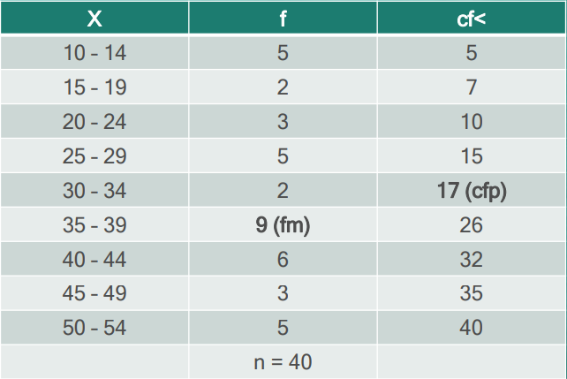
Median
Example: Scores of 40 students in a science class consist of 60 items and they are tabulated below. The highest score is 54 and the lowest score is 10.

Slide 45
Median
Solution:
n/2 = 40/2 = 20
The category containing n/2 is (35 – 39)
Lower Limit of MC = 35
L = 34.5
Cf (or Cfp) = 17
f (or fm) = 9
w = 5
Median = L + (n/2 – Cf) /f * w
= 34.5 +(20-17)/9 *5
= 34.5 + 15/9
= 36.17

Slide 46
Median
Properties
It may not be an actual observation in the data set.
Not affected by extreme values because median is a positional measure.
Can be applied in ordinal level.
When to Use the Median
The exact midpoint of the score distribution is desired.
There are extreme scores in the distribution.

Slide 47
Percentiles
A score below which a specific percentage of the distribution falls.
Finding percentiles in grouped data:

Slide 48



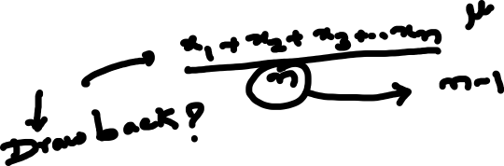
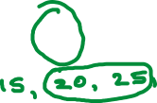
Measures of central tendency
The mean
the median
the mode

Slide 49
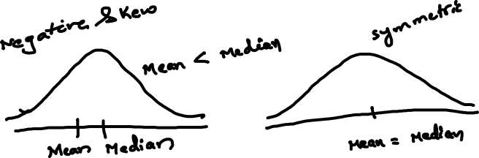
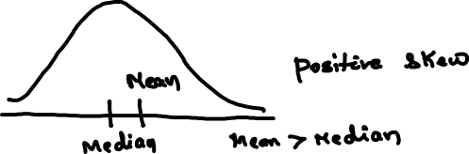

Slide 50
Shape of the Distribution
Symmetrical : mean is about equal to median
Skewed
Negatively : mean < median
Positively : mean > median
Bimodal : has two distinct modes
Multi-modal : has more than 2 distinct modes)
Notes:
Draw Examples on the board

Slide 51
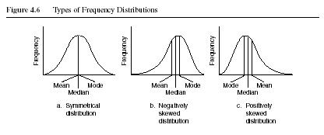
Distribution Shape

Slide 52
Sl. No. | X₁
1 | 2
2 | 8
3 | 5
4 | 3
5 | 7
6 | 8
7 | 5
8 | 2
9 | 5
Total | 45
X₂
1
15
5
5
6
3
5
2
3
45

Slide 53
Sl. No. | X₁
1 | 2
2 | 8
3 | 5
4 | 3
5 | 7
6 | 8
7 | 5
8 | 2
9 | 5
Total | 45
Statistical measures | Group 1
Mean | 5
Median | 5
Mode | 5

Slide 54
Sl. No. | X₂
1 | 1
2 | 15
3 | 5
4 | 5
5 | 6
6 | 3
7 | 5
8 | 2
9 | 3
Total | 45
Statistical measures | Group 2
Mean | 5
Median | 5
Mode | 5

Slide 55
Sl. No. | X₁
1 | 2
2 | 8
3 | 5
4 | 3
5 | 7
6 | 8
7 | 5
8 | 2
9 | 5
Total | 45
X₂
1
15
5
5
6
3
5
2
3
45
Statistical measures | Group 1 & 2
Mean | 5
Median | 5
Mode | 5

Slide 56


Slide 57
Do we need any other measure?
Answer: Yes
Measures of variability
Three Measures of Variability:
The Range
The Variance
The Standard Deviations

Slide 58
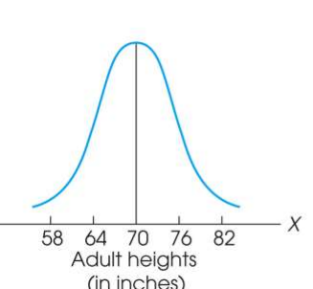
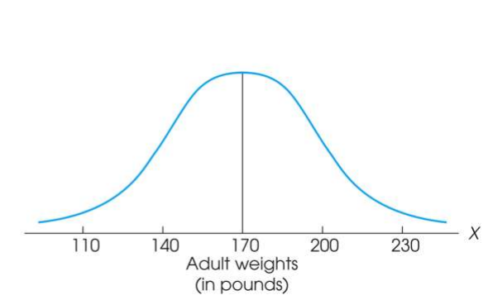
Measure of Variability
Variability can be defined several ways:
A quantitative distance measure based on the differences between scores
Describes distance of the spread of scores or distance of a score from the mean
Purposes of Measure of Variability:
Describe the distribution
Measure how well an individual score represents the distribution

Slide 59
The Three Measures
Three Measures of Variability:
The Range
The Variance
The Standard Deviations

Slide 60
The Ranges
The distance covered by the scores in a distribution – From smallest value to highest value
For continuous data, real limits are used
Based on two scores, not all the data – An imprecise, unreliable measure of variability
Range = URL for X_{max} - LRL for X_{min}
Example: For a set of scores: 7, 2, 7, 6, 5, 6, 2
Range = Highest Score minus Lowest score = 7 - 2 = 5

Slide 61
The Standard Deviation
Most common and most important measure of variability is the standard deviation
A measure of the standard, or average, distance from the mean
Describes whether the scores are clustered closely around the mean or are widely scattered
Calculation differs for population and samples
Variance is a necessary companion concept to standard deviation but not the same concept

Slide 62
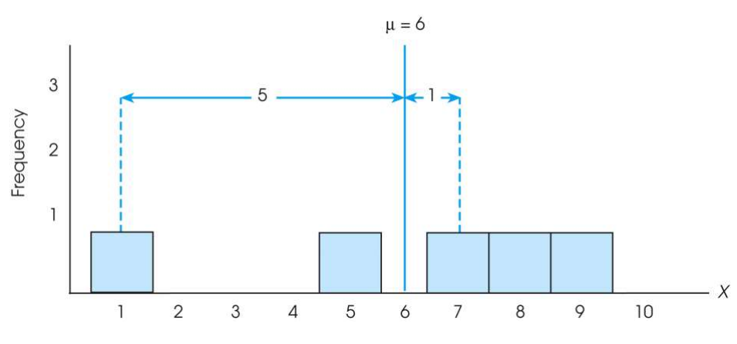

The Standard Deviation
Exercise : Find out the deviations of all the data points with the mean….and then find the ‘mean deviation’.

Slide 63

The Standard Deviation
Mean deviations will always be ‘zero’ !
(because Mean is a balance point)
Then, how do you find ‘Standard Deviation’ ?
Need a new strategy

Slide 64

The Standard Deviation
New Strategy :
First square each deviation score
Then sum the Squared Deviations (SS)
Average the squared deviations
Mean Squared Deviation is known as “Variance”
Variability is now measured in squared units

Slide 65
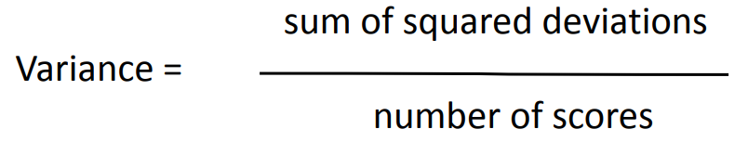
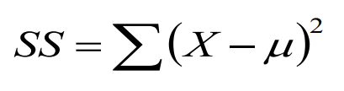
The Variance
Variance equals mean (average) squared deviation (distance) of the scores from the mean
where

Slide 66
The Population Variance
Population variance equals mean (average) squared deviation (distance) of the scores from the population mean
Variance is the average of squared deviations, so we identify population variance with a lowercase Greek letter sigma squared: σ 2
Standard deviation is the square root of the variance, so we identify it with a lowercase Greek letter sigma: σ

Slide 67
Sl. No. | X₁
1 | 2
2 | 8
3 | 5
4 | 3
5 | 7
6 | 8
7 | 5
8 | 2
9 | 5
Total | 45
Statistical measures | Group 1
Mean | 5
Median | 5
Mode | 5

Slide 68
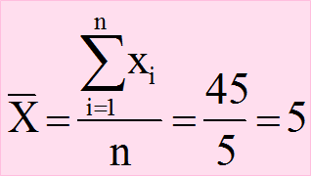
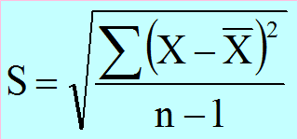
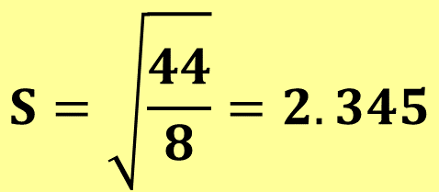
Sl. No. | X₁
1 | 2
2 | 8
3 | 5
4 | 3
5 | 7
6 | 8
7 | 5
8 | 2
9 | 5
Total | 45
$$S=\sqrt{\frac{44}{8}}=2.345$$

Slide 69
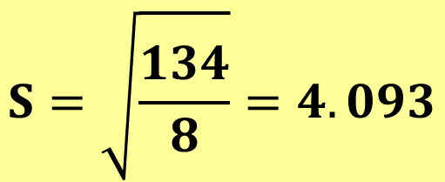
Sl. No. | X₂
1 | 1
2 | 15
3 | 5
4 | 5
5 | 6
6 | 3
7 | 5
8 | 2
9 | 3
Total | 45
$$S=\sqrt{\frac{134}{8}}=4.093$$

Slide 70
Learning Check
If all the scores in a data set are the same, the Standard Deviation is equal to 1.00
The standard deviation measures …
(1) Sum of squared deviation scores
(2) Standard distance of a score from the mean
(3) Average deviation of a score from the mean
(4) Average squared distance of a score from the mean
True / False ?
Select the correct option

Slide 71
Solution
If all the scores in a data set are the same, they are equal to the mean and hence the deviation from mean = 0 therefore, Standard Deviation is equal to zero
The standard deviation measures …
(1) Sum of squared deviation scores
(2) Standard distance of a score from the mean
(3) Average deviation of a score from the mean
(4) Average squared distance of a score from the mean
False

Slide 72
Standard Deviation and Variance for a Sample
Goal of inferential statistics:
Draw general conclusions about population
Based on limited information from a sample
Samples differ from the population
Samples have less variability
Computing the Variance and Standard Deviation in the same way as for a population would give a biased estimate of the population values

Slide 73
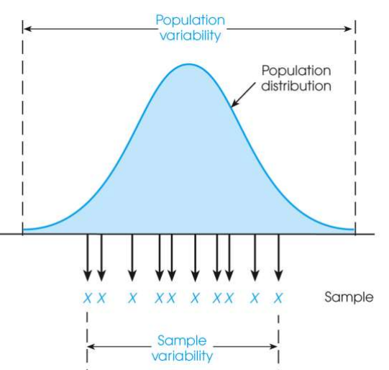
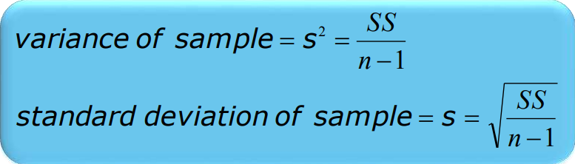
Sample Standard Deviation and Variance
Sum of Squares (SS) is computed as before
Formula for Variance has n-1 rather than N in the denominator
Notation uses s instead of σ
Population of Adult Heights

Slide 74
Degrees of Freedom
Population variance
Mean is known
Deviations are computed from a known mean
Sample variance as estimate of population
Population mean is unknown
Using sample mean restricts variability
Degrees of freedom
Number of scores in sample that are independent and free to vary
Degrees of freedom (df) = n – 1

Slide 75
Learning Check
Select the correct option
A sample of four scores has SS = 24. What is the variance?
The variance is 6
The variance is 7
The variance is 8
The variance is 12
A sample systematically has less variability than a population
The standard deviation is the distance from the Mean to the farthest point on the distribution curve
True / False ?
True / False ?

Slide 76
Solution
Select the correct option
A sample of four scores has SS = 24. What is the variance?
The variance is 6
The variance is 7
The variance is 8
The variance is 12
Extreme scores affect variability, but are less likely to be included in a sample
The standard deviation extends from the mean approximately halfway to the most extreme score
True
False

Slide 77
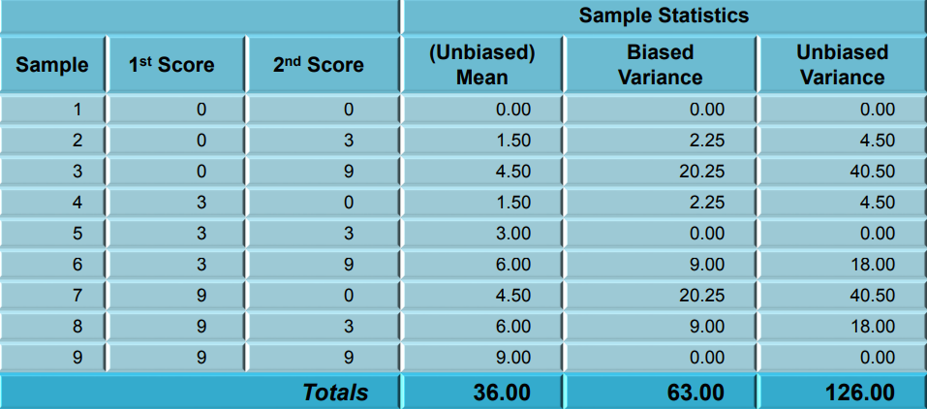
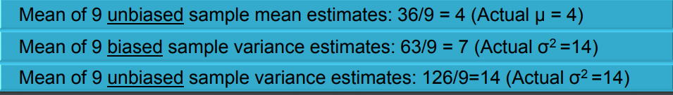
Biased and Unbiased Estimates

Slide 78
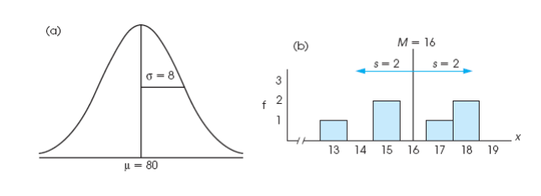
Descriptive Statistics
A standard deviation describes scores in terms of distance from the mean
Describe an entire distribution with just two numbers (M and s)
Reference to both allows reconstruction of the measurement scale from just these two numbers
Means and standard deviations together provide extremely useful descriptive statistics for characterizing distributions

Slide 79
Interquartile range (IQR)
Measure of Variation
Also Known as Midspread: Spread in the Middle 50%
Difference Between Third & First Quartiles:
Not Affected by Extreme Values
Interquartile Range = Q₃ – Q₁
Data in Ordered Array: 11 12 13 16 16 17 17 18 21
1•(9 + 1)
Position of Q₁
=
= 2.50,
Q₁
=12.5
4
3•(9 + 1)
Position of Q₃
=
= 7.50,
Q₃
=17.5
4
Interquartile Range = Q₃ – Q₁ = 17.5 - 12.5 = 5

Slide 80
Box and Whisker plot
97.5th Centile
75th Centile
Q₁
MEDIAN
(50th centile)
Q₂
25th Centile
Q₃
Inter-quartile range
2.5th Centile

Slide 81
Box and Whisker plot
IQR = Q₃ – Q₁
Q₁-1.5 IQR
Q₃+1.5 IQR
Min
Max
Q₁
Q₂
Q₃
Outlier
Outlier

Slide 82
Box-and-Whisker plot
IQR = Q₃ – Q₁
Min
Q₁-1.5 IQR
Q₃+1.5 IQR
Max
Q₁
Q₂
Q₃
Q₃+3 IQR
Q₁-3 IQR
Major Outlier
Major Outlier

Slide 83
Thanks

